Slide 1
Text-to-SPARQL
By: Shahriar Yazdipour
Dr. Nadine Steinmetz
November 2021

Slide 2
Agenda
Intro
RDF and SPARQL
Transformers
T5
Our Model
Samples
Q&A

Slide 3
Intro
Our Goal
In this study we present a model, which generates SPARQL queries based on the input question given to the model.
The Text-to-SPARQL model is a transformer encoder-decoder based architecture, pre-trained for translation task on the Google Brain T5 model.
We applied two models’ sizes based on the Seq2Seq Hugging Face T5 Transformer framework by utilizing NVIDIA GPUs.
Notes:
(after 1) We have carried out experiments with different training strategies, different datasets to build this model.

Slide 4
Intro
RDF (Resource Description Framework)
RDF is a general method of describing data by defining relationships between data objects.
Built around the existing Web standards: XML and URL (URI).
RDF enables effective data integration from multiple sources, detaching data from its schema.
This allows multiple schemas to be applied, interlinked, queried as one and modified without changing the data instances.
Notes:
(*FIRST) The Web is growing every day and producing a tremendous amount of data is becoming common for companies and communities. Moreover, this immense volume of information complicates the access of a given desired data.

Slide 5
Intro
SPARQL
SPARQL is the standard query language.
Used for manipulating and retrieving information contained in RDF graphs
Using it needs
an understanding of the entities in the field to be queried
knowledge about the syntax and semantics of the language
That is why its application is commonly narrowed to a group of Semantic Web experts skilled in the query language.
To make it more accessible, researchers are working on ways to translate questions from natural language to SPARQL over the last years.
Notes:
(END) New progress in Deep Learning and NLP has proved that it is promising to understand, parse and translate languages to other languages.
Question Answering (QA) models give users friendly interfaces that hide the complexity of writing such formal query languages as SPARQL.
These interfaces help the users to work with questions using their natural language.

Slide 6
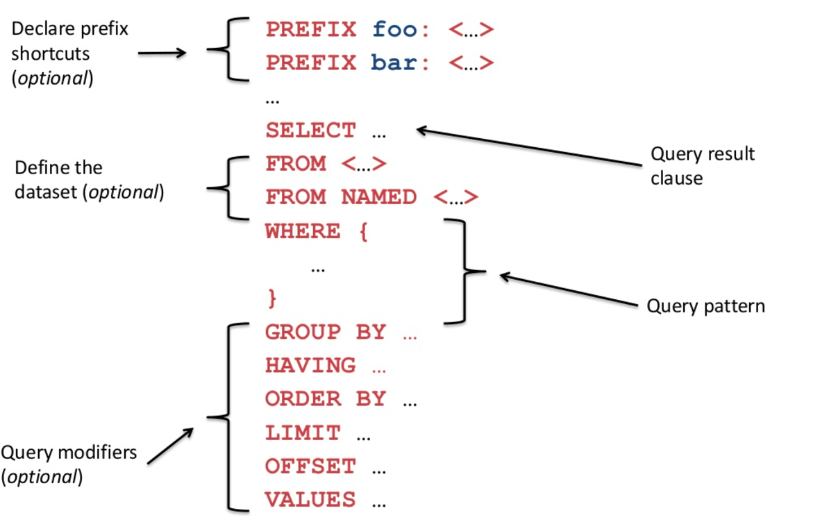
Intro
SPARQL

Slide 7
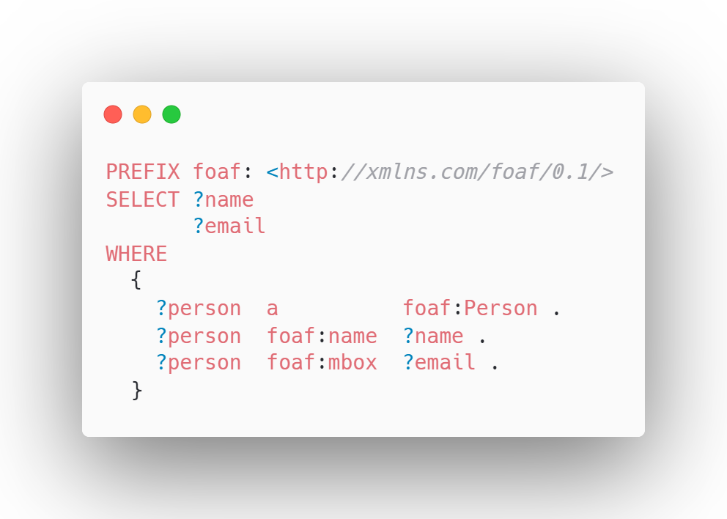
Intro
SPARQL
Returns names and emails of every person in the dataset:
Notes:
This simple query that leverages the ontology definition foaf ("friend of a friend").
This query joins together all of the triples with a matching subject, where the type predicate, "a", is a person (foaf:Person), and the person has one or more names (foaf:name) and mailboxes (foaf:mbox).

Slide 8
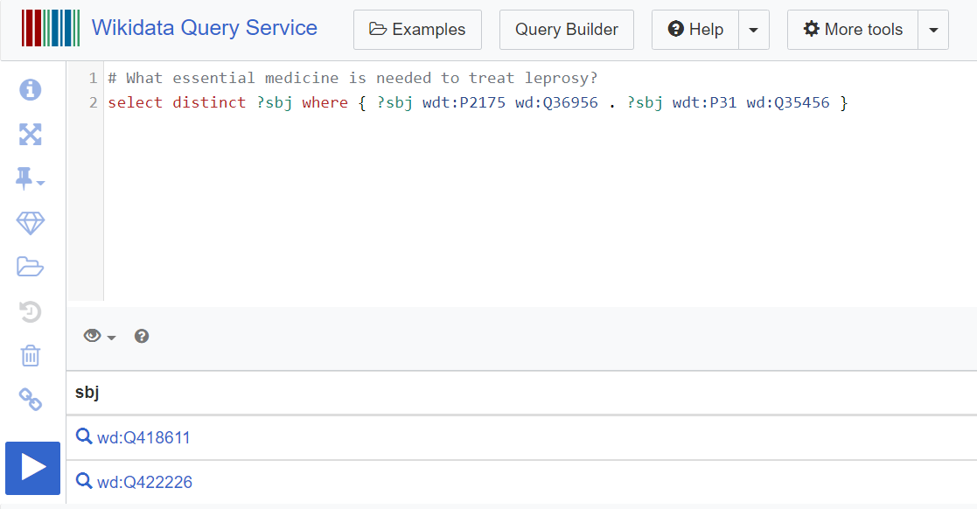
Intro
Wikidata SPARQL

Slide 9
Related Works
Text to SPARQL
TBSL is a template-based query system that uses SPARQL to generate query structures that resemble the original query.
It is commonly used to detect the existence of the entity and predicate clauses.
In SINA (Semantic interpretation of user queries for question answering),
the SPARQL query is formulated through a knowledge base that explores the possibilities of resource matching.
It is identified by a query type derived from predefined rules and resources linked using DBpedia Spotlight.
uses a hidden Markov model to determine the most suitable resources for a user-supplied query from different datasets.
In SPARQL as a Foreign Language, they used an LSTM encoding-decoder model to encode natural language.
Notes:
There are some researches regarding QA approaches in converting an NL question into a SPARQL query.
There are methods in retrieving the answer from a triple store by generating multiple Basic Graph Patterns or computing observed patterns.

Slide 10
Transformers
Many essential and excellent works start around 2015 about Word2Vec to map words and encode some meaning about them in continuous space.
An important paper in 2017 by OpenAI (Learning to generate reviews and discovering sentiment), showed that by just training a language model on a purely unsupervised objective, the model could learn concepts that were potentially useful for downstream tasks.
In 2018, ULMFiT, which took the recipe from semi-supervised sequence learning, added some tweaks, figured out how to get it working better, and got some noble results with a similar pipeline, pre-training a language model, fine-tuning on a downstream task.
Notes:
(1st)-There were many excellent works around 2015 on learning word vectors to continuous representations for words where the identity of a word was mapped to a fixed-length vector which ideally encoded some meaning about the word in a continuous space.
(1st)-That has been an essential part of the NLP pipeline, especially for deep learning models where these pre-trained word-vectors were trained using an unsupervised objective, and new models were fed and trained on top of them.
(1st)-An important paper in 2017 that helped researchers change their way of thinking towards the transfer learning paradigm was the unsupervised sentiment neuron paper from people at OpenAI, which essentially showed that by just training a language model on a purely unsupervised objective, the model could learn concepts that were potentially useful for downstream tasks.

Slide 11
Transformers
ELMo showed that we could get significantly better performance by using a bi-directional language model.
GPT1 showed we can get good performance by using a transformer with a language model.
Finally, in 2018, BERT convinced many researchers that a bi-directional transformer could get outstanding performance.

Slide 12
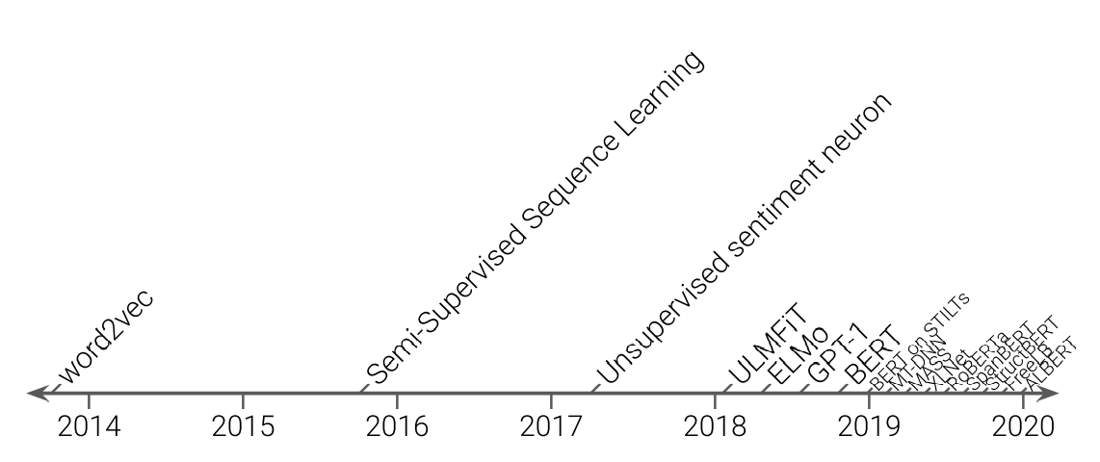
Transformers

Slide 13
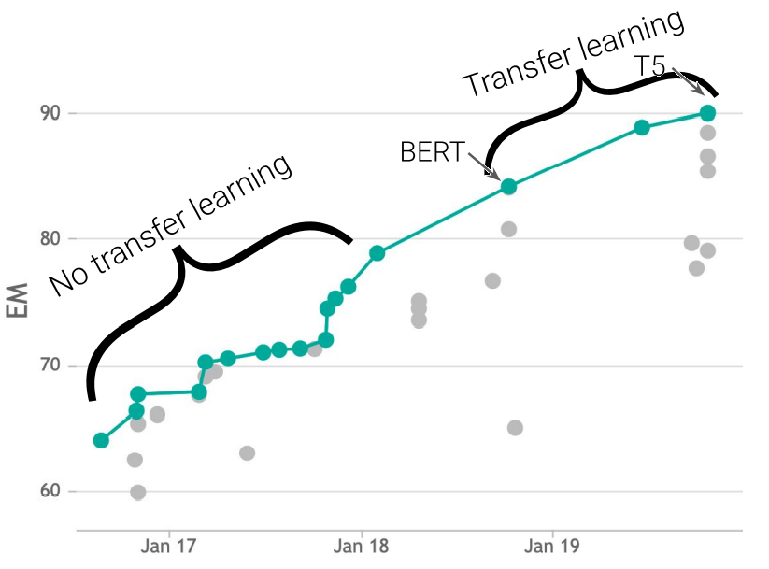
SQuAD Exact Match score
Notes:
U can see scores over time for the squad benchmark or Stanford Question Answering Dataset –it is a QA benchmark on the validation set and you can see that when the benchmark was proposed we were having a score of around 70% ….
(this is the exact match score basically saying does the span predicted by the exactly match the correct)
- I should mention that Because humans create the SQuAD questions and answers by crowd-sourcing, it is more distinct than other QA datasets and a great source to compare various NLP models.

Slide 14
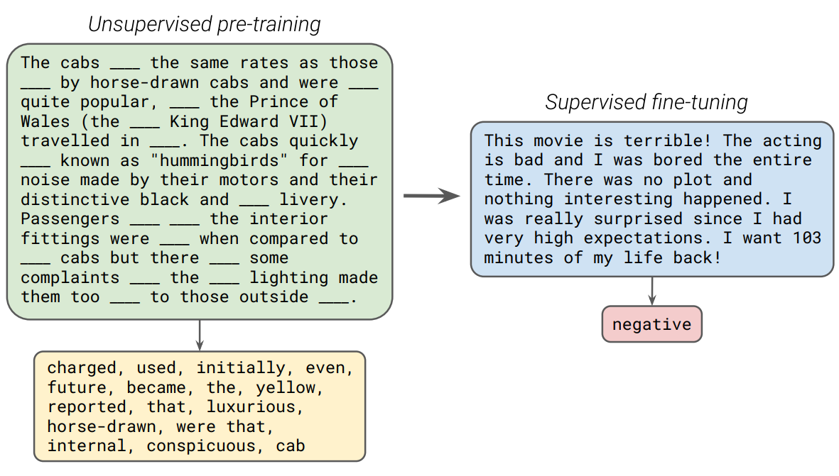
Transformers
Notes:
We usually start by training our model in an unsupervised fashion on unlabeled data and then fine tuning it on a labeled data set for some tasks that we actually care about which I'll call the downstream tasks
so for example we might take some text, shown in green box here, drop out some of the words and train the model to predict the missing words
after that's done we will fine-tune it on a supervised tasks like sentiment analysis classification like the blue box

Slide 15

T5
Exploring Transfer Learning with T5: the Text-To-Text Transfer Transformer from Google Brain
Notes:
T5's basic idea is that it models every NLP problem and every text problem as a text-to-text task
that takes the text as input and produces text as output.
So fundamentally, it is in a sequence-to-sequence framework, and T5 is perfectly suitable for transfer learning machine translation.
T5 can handle various tasks, and it can be fine-tuned for different NLP tasks, such as summarization, COLA (Corpus on linguistic acceptability), classification, multiple text translation, also regression problems like STSB that predicts how similar two sentences are.
Because the same model is used for many tasks, the model understands which tasks to perform by prepending a prefix.
In our case prefix is: "translate text to SPARQL:".
By the end of fine-tuning, T5 will have "n" different models where "n" is the number of tasks.
(#Cola this is the corpus on linguistic acceptability where you’re given a sentence and you have to decide whether it's linguistically acceptable so basically grammatically correct or not)
(#STSB where we're basically tasked to predict how similar two sentences)

Slide 16
T5
T5 Model implemented by Raffel et al. (2020) at Google Brain
Sequence-to-Sequence framework
Uses the BERT encoder-decoder architecture
Using C4 Dataset for pretraining
Originally T5 was introduced with five pre-trained models
Small (60 million parameters)
Base(220 million parameters)
Large(770 million parameters)
3B(3 billion parameters)
11B(11 billion parameters)

Slide 17

Model - BERT
Notes:
#so as far as the model itself that's it's just a standard sort of vanilla encoder decoder transformer so
as proposed ‘’Attention is all you need’’ we use relative position embeddings and uses sort of a scale only layer normalization

Slide 18
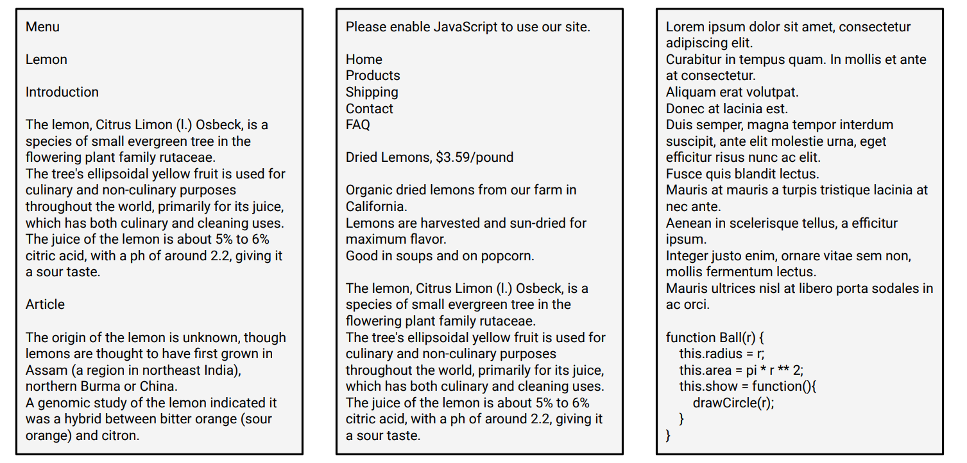
Common Crawl Web Extracted Text
Notes:
#one of the reasons that transfer learning recipe has been so successful
is that we do unsupervised pretraining and it's very easy to get a bunch of natural text from the internet
for example many people have used pages from wikipedia as pre-training data
# common crawl is a sort of non-commercial initiative to crawl the web and save snapshots of the web and every month they put out a dump of web content on the order of 20 terabytes depending on the month
T5 basically took their dumped content and applied some filtering to it to create a new data set

Slide 19
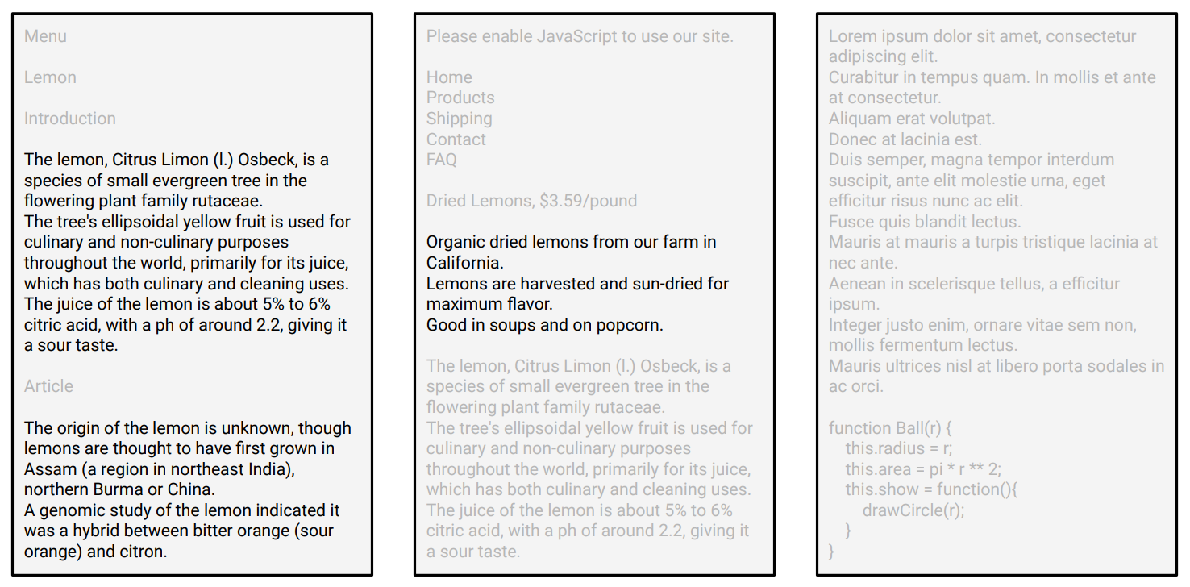
Colossal Clean Crawled Corpus (C4)

Slide 20
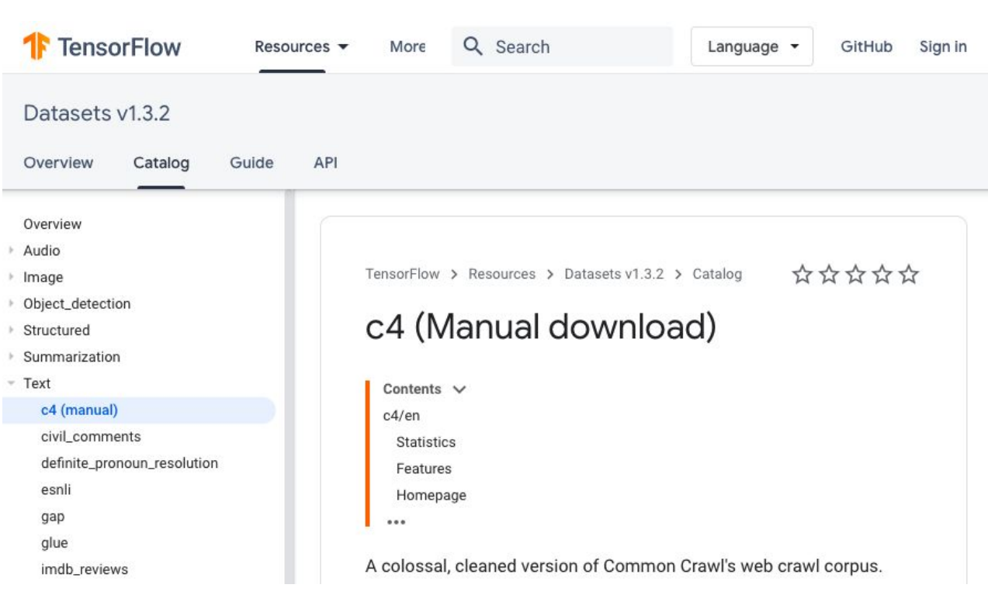
Colossal Clean Crawled Corpus (C4)
Notes:
750Gig

Slide 21
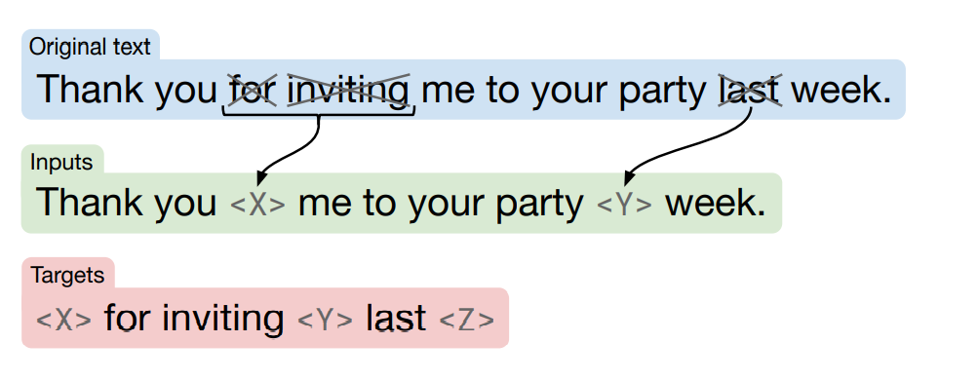
Pre-Training
Notes:
To pre-train the T5 model, we start with clean text and drop some words to corrupt the text.
Each dropped-out span will be replaced with a unique token, words are also dropped out independently at random.
Then the model is trained to output tokens to fill the dropped-out text.
This method is pretty similar to the span BERT objective. It is tried to produce an objective that was not too different from standard practice.

Slide 22
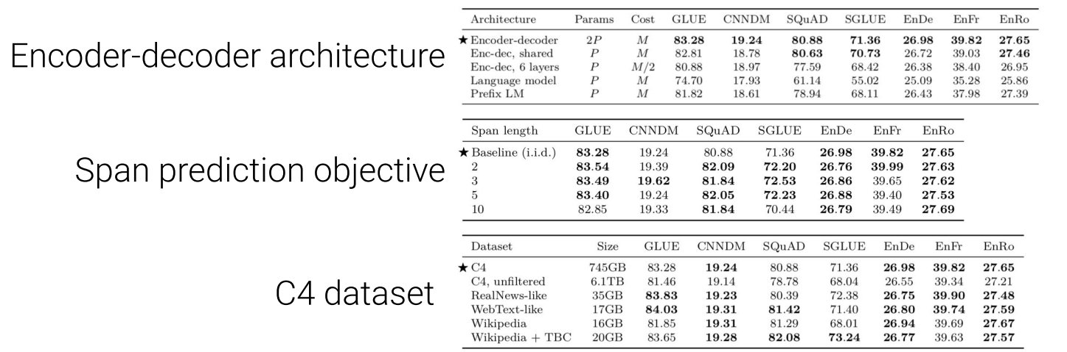
Different Approaches
Notes:
EM = Exact match

Slide 23
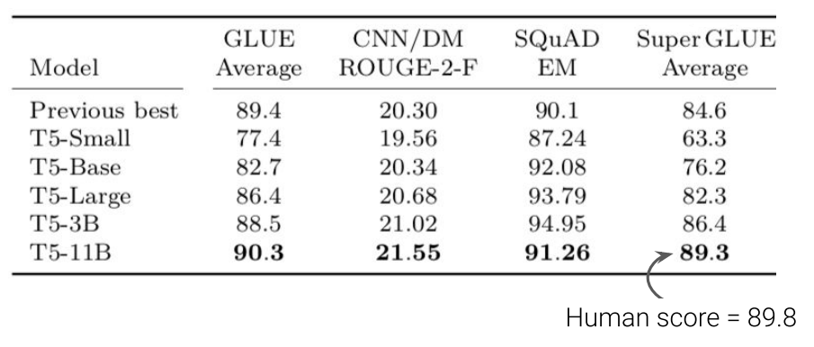
T5 Models

Slide 24
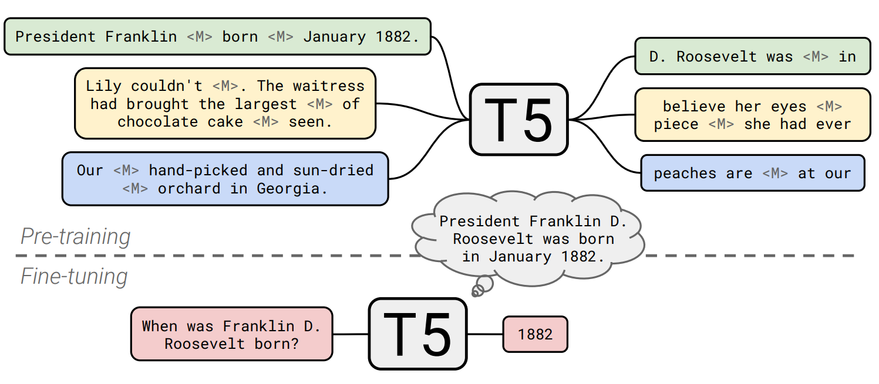
Training

Slide 25

Our Model
Fine-Tuning T5 for SPAQL
LC-QuAD v2 Dataset
T5Tokenizer - Sentence Piece Tokenizer
"translate English to Sparql: " prefix
AdamW Optimizer
After pre-training
250MB model based on T5-Small
850MB model based on T5-Base

Slide 26




Tools
Huggingface is all you need

Slide 27
Dataset
LC-QuAD v2.0
English Question Text and its equivalent Wikidata SPARQL query
Include Paraphrased question
Contains "template" and other properties that we did not use
Replace Brace with Brackets
Convert WikiData P-IDs and Q-IDs to english vocabularies
48148 records after preprocessing (24074 records original)
38586 training data
9562 test data

Slide 28
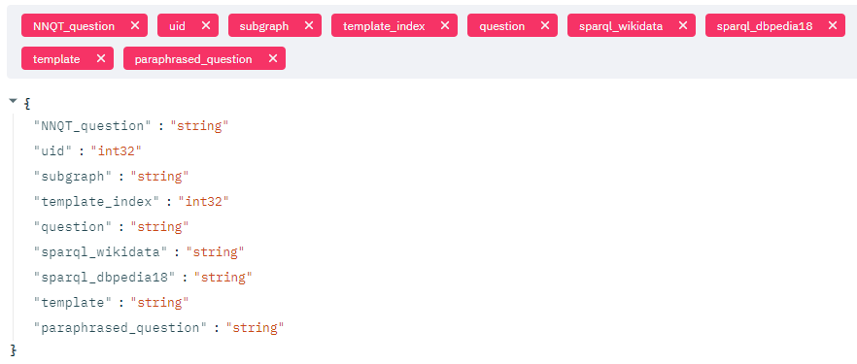
Wikidata - LC-QuAD
Data Sample

Slide 29
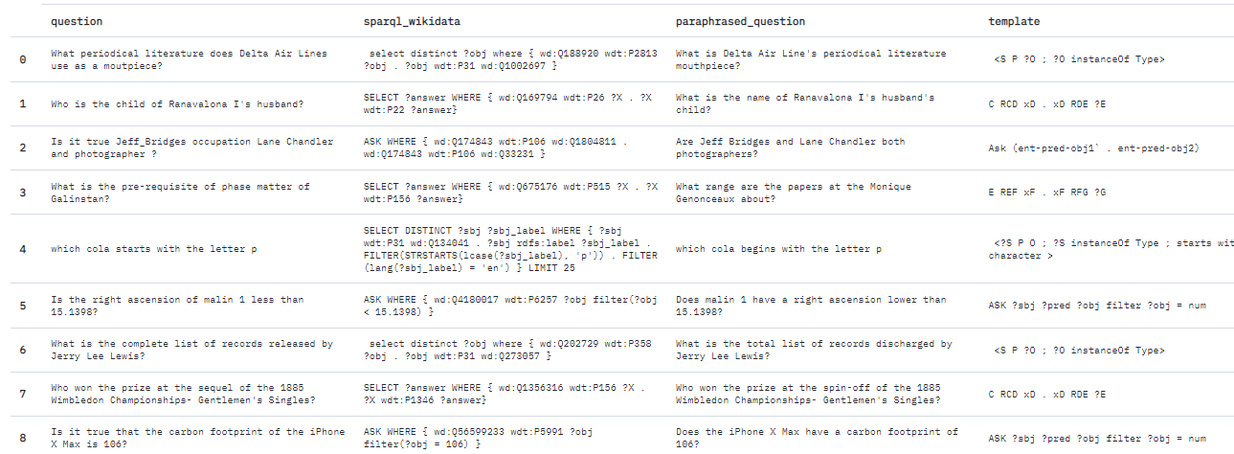
Wikidata - LC-QuAD
Data Sample

Slide 30
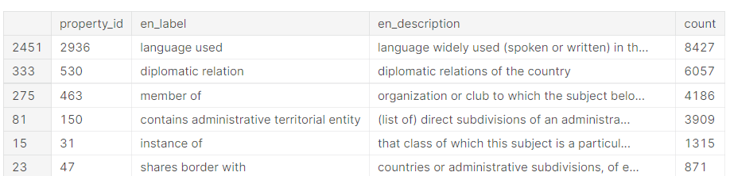
Dataset
KDWD
Dataset from Kensho R&D
4 Gigabytes
Contains WikiData properties and items labels and their Q-ID and P-IDs
https://www.kaggle.com/kenshoresearch/kdwd-wikidata-small-ontology

Slide 31
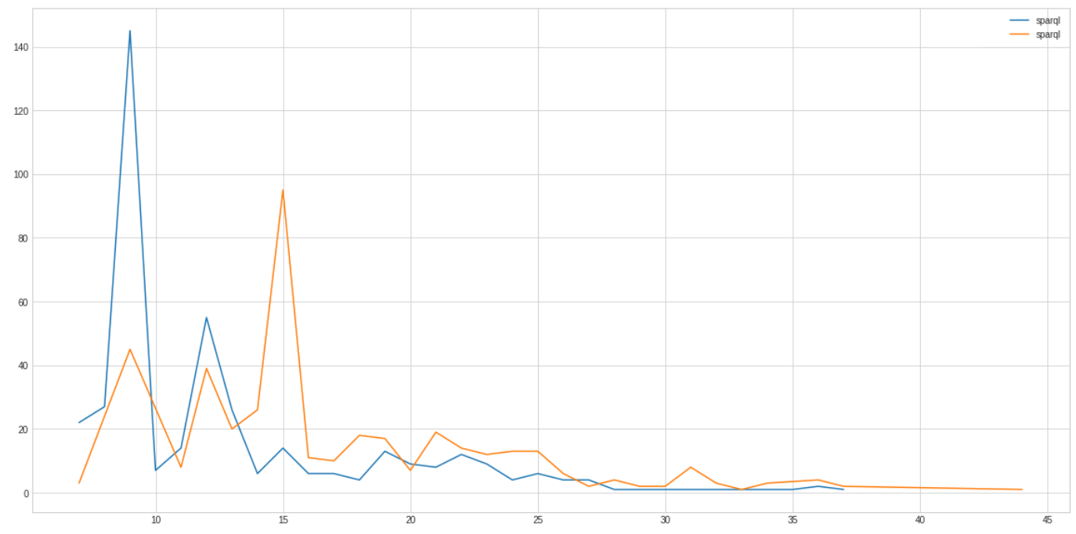
Dataset
QALD9
DBPedia only dataset
(+) Supports multiple languages
(+) Properties are not encoded by P-ID/Q-IDs (queries more readable for humans also for LM)
(-) Quantity of the data, less than a thousand records (not suitable for a deep learning study)
Essential preprocessing step to reduce queries length
Created a small dictionary of all common referenced URIs and used them as prefixes
kurtosis: 11.8 to 18.0 skew: 3.1 to 4.0
Max char length: 461 to 388 std: 61.7 to 49.9

Slide 32
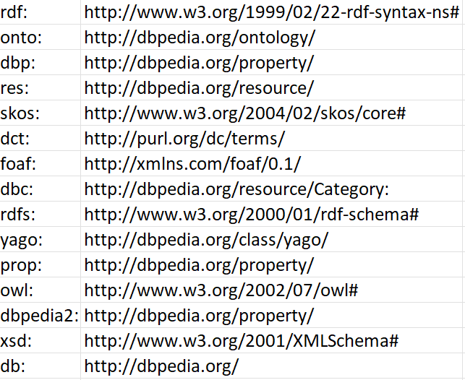
DBPedia – QALD
Prefix

Slide 33
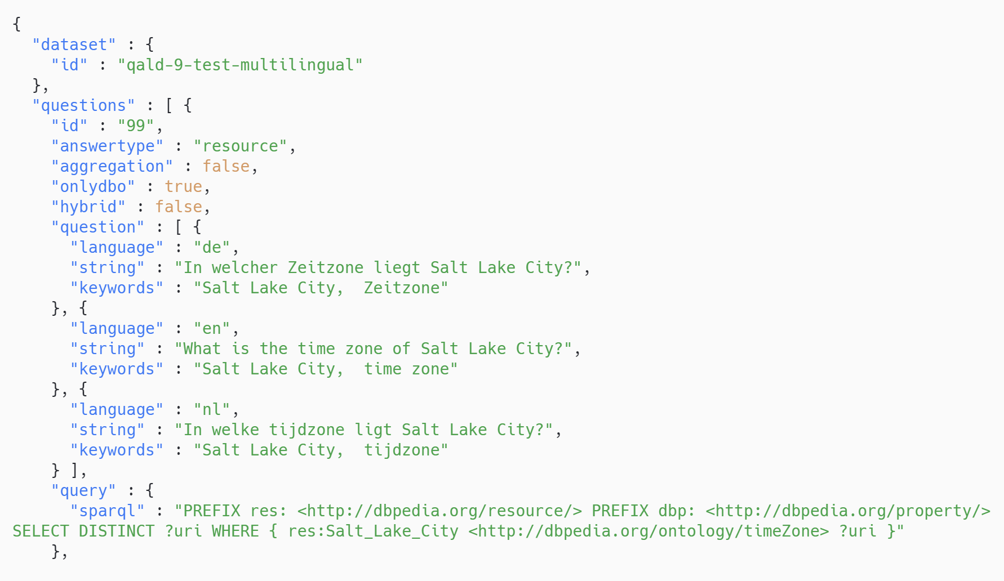
DBPedia – QALD
Data Sample

Slide 34
Hardware
Tesla K80 GPU
11441MiB Memory
FP16 mixed-precision = Off
Train T5-small in more than 2 hours
Train T5-base model in about 6 hours
FP16 mixed-precision = On
Train T5-small in 50 minutes
Train T5-base model in 2 hours
Notes:
Converting a model to use float16 instead of float32 can decrease the model size (up to half) and improve performance on some GPUs.
There may be some accuracy loss, but in many models the new accuracy is acceptable.
Tuning data is not needed for float16 conversion, which can make it preferable to quantization.

Slide 35
Results
In 4807 training steps and 8 batch size
31% Training Loss
23% Validation Loss
no over-fitting
Our aim was to make the validation loss as low as possible
Notes:
If validation loss >> training loss you can call it overfitting.
If validation loss > training loss you can call it some overfitting.
If validation loss < training loss you can call it some underfitting.
If validation loss << training loss you can call it underfitting.
Your aim is to make the validation loss as low as possible. Some overfitting is nearly always a good thing. All that matters in the end is: is the validation loss as low as you can get it.

Slide 36
Results
BLEU
BLEU scores calculate the number of n-grams in common between the predicted translation and the gold standard.
Comparing BLEU scores is more complex than it should be.
After fine-tuning we got
6.45 SacreBLEU score for Base model
5.95 for the Small model

Slide 37
Results
Using BERTScore, we leveraged the pre-trained contextual embeddings from BERT and match words in candidate and reference sentences by cosine similarity.
BERTScore measures precision, recall, and F1 measure, which can help evaluate different tasks.
This approach provides better evaluation for sentences that use synonyms or similar words.

Slide 38
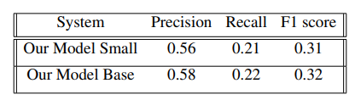
Results
Wikidata - LC-QuAD

Slide 39
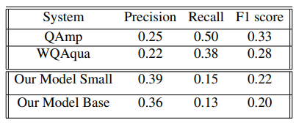
Results
Wikidata - LC-QuAD
DBPedia
Notes:
After fine tuning our model, we used QALD 9 to fine tune it over our model in a different task, with `translate english to sparql2:` prefix.
Obviously with the low quantity of data and no pre-processing on Sparql-DBPedia data, we were able to achieve acceptable results with SacreBLEU Score of 10 for Base and 9.3 for Small model.
Comparing these scores to other state of the art studies, QAmp and WQAqua.
We can see our model is behaving differently with higher precision but with lower recall.

Slide 40
Results
QAmp
WQAqua
2020
LC-QuAD DBPedia QALD9 Only for Benchmarking
Unsupervised message-passing algorithm
2021
3 Datasets
Monument dataset + LC-QuAD + DBNQA
894,499 records
2-layer LSTMs, ConvS2S 15-layer, FairSEQ model
3 GPUs
Notes:
Unsupervised Neural Hidden Markov Models: which allows for efficient reasoning under uncertainty using text similarity and the graph structure
(generated + manually crafted template pairs)
Due to the limitation and the complexity of SPARQL, only a subset of SPARQL operators are included in the target SPARQL queries of the involved datasets, which are: SELECT, ASK, DISTINCT, WHERE, FILTER,ORDER BY, LIMIT, GROUP BY, and UNION.

Slide 41
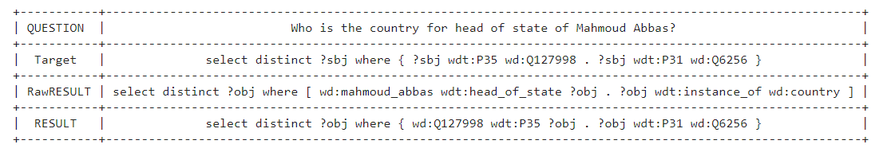
Samples
Wikidata - LC-QuAD

Slide 42
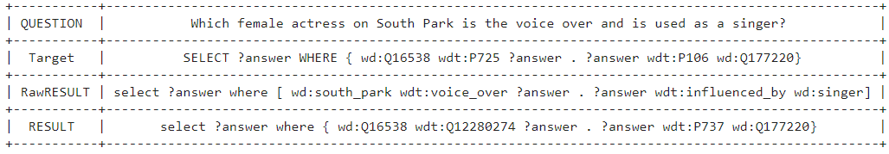
Samples
Wikidata - LC-QuAD

Slide 43
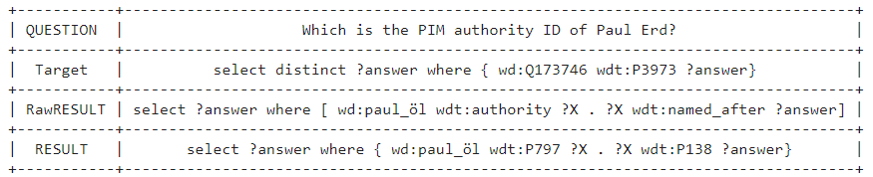
Samples
Wikidata - LC-QuAD

Slide 44
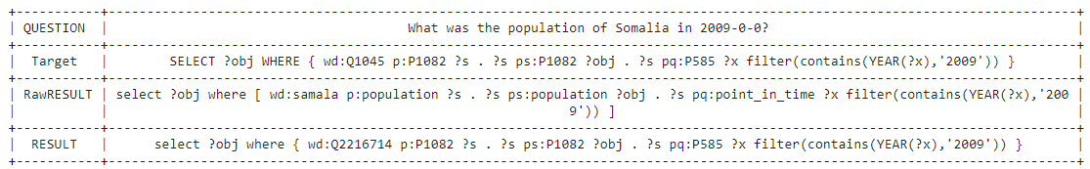
Samples
Wikidata - LC-QuAD

Slide 45
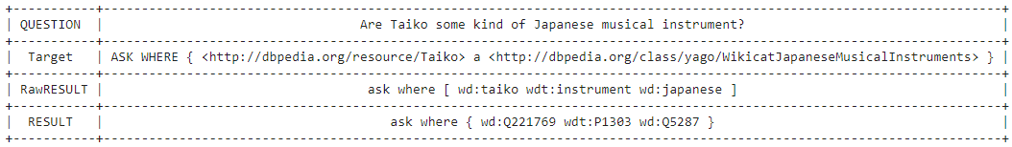
Samples
Wikidata - LC-QuAD

Slide 46
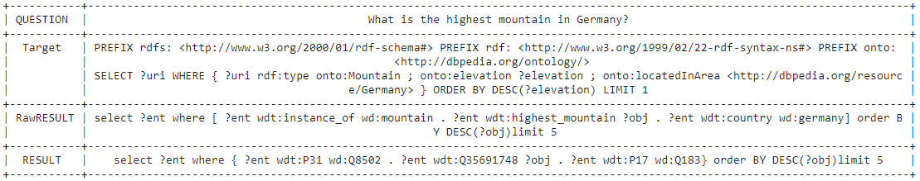
Samples
Wikidata - LC-QuAD

Slide 47
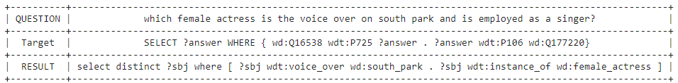
Samples
DBPedia – QALD

Slide 48
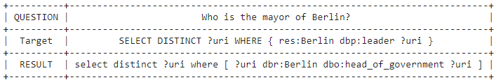
Samples
DBPedia – QALD

Slide 49
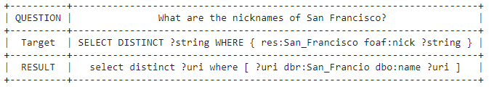
Samples
DBPedia – QALD

Slide 50
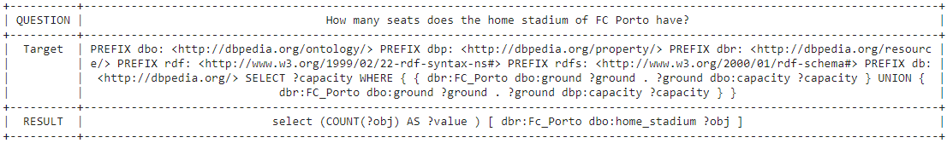
Samples
DBPedia – QALD

Slide 51

Access
Our fine-tuned models and customized datasets are publicly available at this huggingface page
https://huggingface.co/yazdipour/text-to-sparql-t5-small
https://huggingface.co/yazdipour/text-to-sparql-t5-small-qald9
The codes needed to replicate all fine-tuning processes and use of the model are accessible from this public repository
https://github.com/yazdipour/text-to-sparql
https://github.com/yazdipour/text-to-sparql-development

Slide 52
Future work
Study on DBPedia only Datasets
Work on cleaner and bigger Dataset
Create a clean DBPedia dataset from LC-QUAD
Changing hyperparameters like different learning rate
Adding a layer of lemmatization to the end
or improve the finding strategy of properties in the WikiData dataset

Slide 53
Thank you for your attention
shahriar.yazdipour@tu-ilmenau.de
https://yazdipour.com
Credits:p. 1: Chris Liebold, p.2: iStockphoto.com/Creativeye99, p. 3/1 iStockphoto.com/Creativeye99 p. 3/2 Siemens AG, p. 16: Christian Meyer, p. 17: iStockphoto.com/Creativeye99, p. 20/1: Rüdiger Horn, p. 22: Nürnberg Luftbild/Hajo Dietz, p. 23/1: Thiemo Reindel, p. 23/2: hsf studentenradio e.V., p. 23/3: Christoph Gorke, p. 24/1: Thomas Golda, 24/2: Johann Lembach, p. 25: helibild, alll others: Michael Reichel

